Slide 1



Clinic Booking System
Supervisor:
Mr. Nguyễn Trung Kiên
Team Members:
Khương Văn Hùng (Leader)
Phan Trương Thảo
Hà Hữu Việt
Nguyễn Văn Trung
Trần Thành Lam
Đinh Thị Tươi

Slide 2

Application Roles/Actors

Slide 3

Roles of project
Guest
Patient
Doctor
Staff
Marketting
Admin

Slide 4
USER CASE - GUEST
Register
Doctors
Guest
Blogs
Home
Services
Contact

Slide 5
USER CASE - ADMIN
Dashboard
Settings
Accounts Manage
Appointment Manage
Admin
Reservations Manage
Doctors Manage
Patients Manage
Blogs Manage
Services Manage

Slide 6
USE CASE - Marketing
USE CASE - Staff
Manage Doctor
Manage Patient
Marketing
Manage Service
Manage Blog
Marketing
Appointment Manage
Reservations Manage

Slide 7
USE CASE - PATIENT
User Profile
Appointment History
Doctors List
Reservation History
Patient
Payment
Services List
Book Appointment
Reserve a Service

Slide 8
USE CASE - DOCTOR
User Profile
My Patient Details
Doctor
My Appointments
My Feedbacks
My Appointment Details
My Patients

Slide 9

Application Design

Slide 10
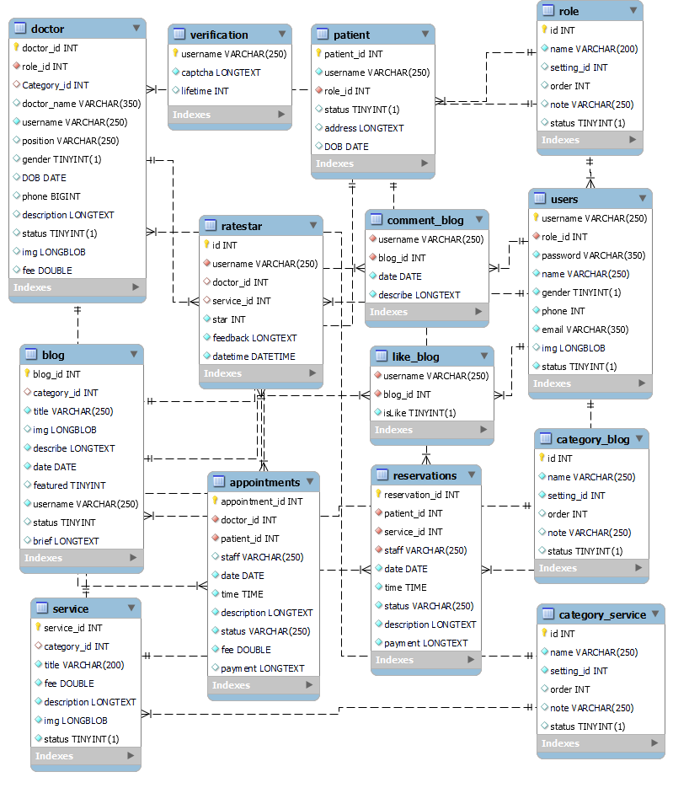
Database schema

Slide 11
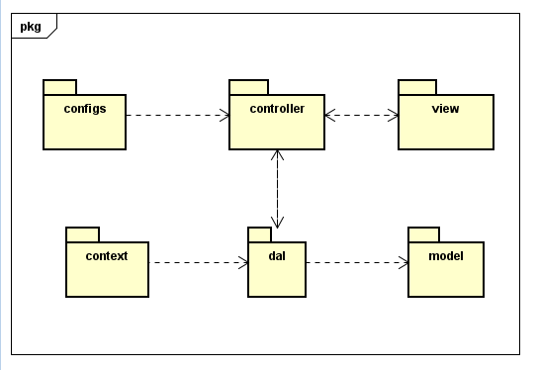
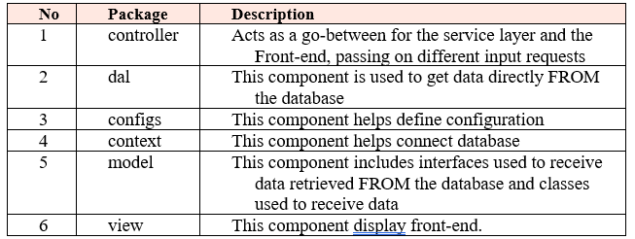
Package diagram

Slide 12
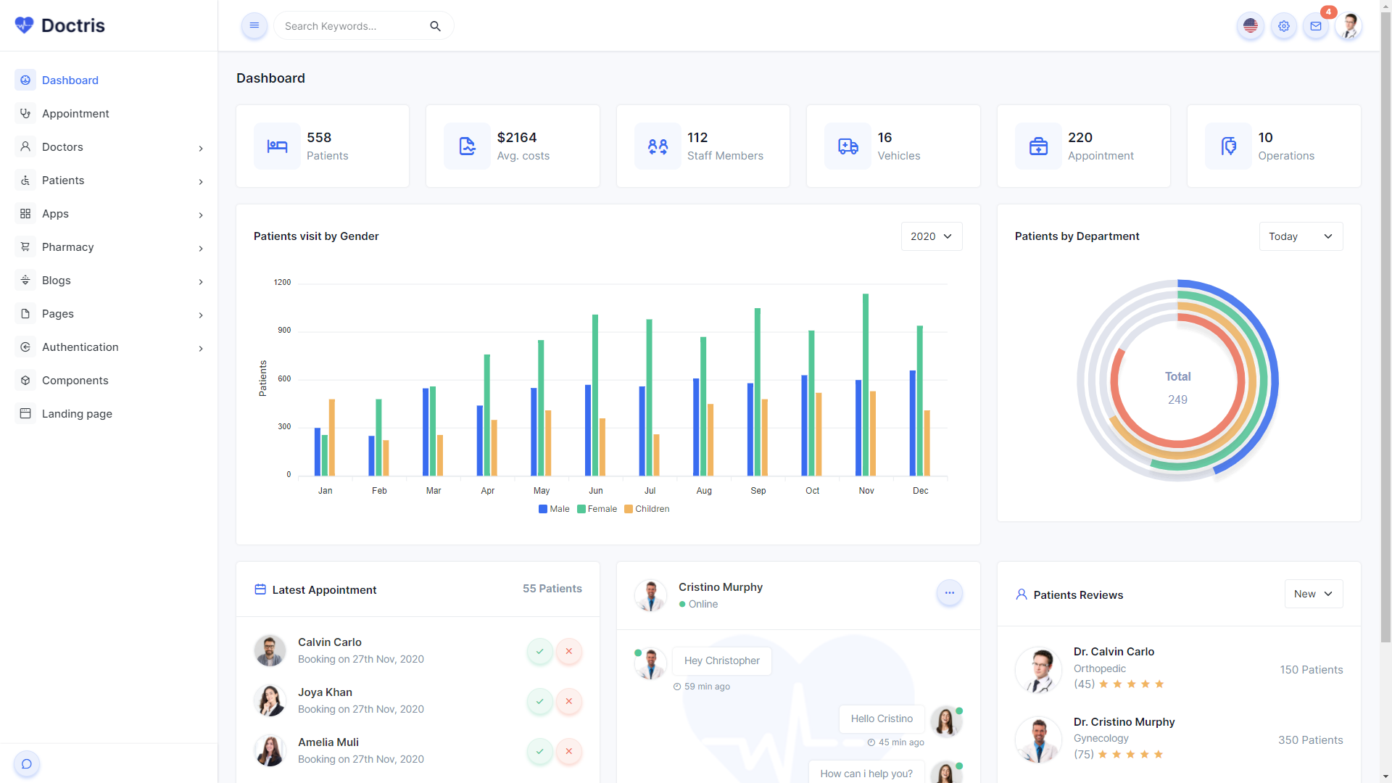

UI Design
Theme: shreethemes.in

Slide 13
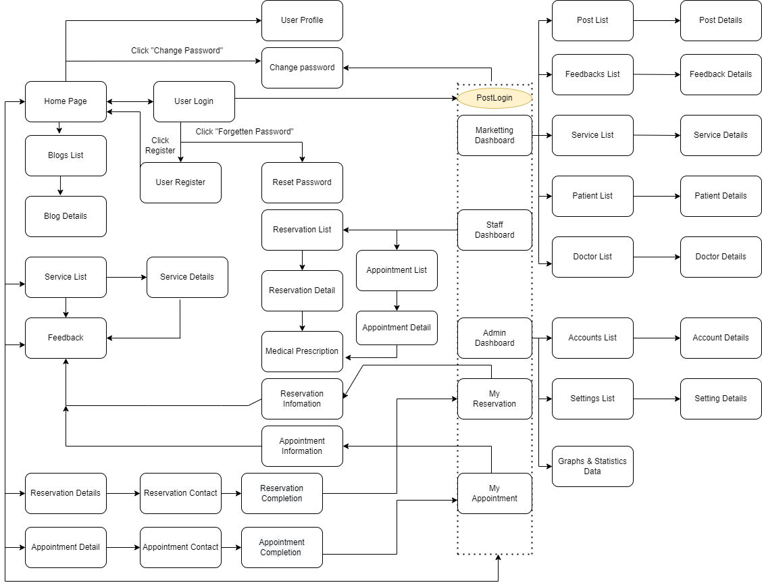
Screen Flow

Slide 14

Project Results

Slide 15
Status of the project
All functions are working properly
User-friendly interface, easy to use

Slide 16
Lessons learned
Teamwork skills
Source code management skills: Gitlab
Database management skills
Project building skills through requirement

Slide 17

The end
Thanks for listening

